Slide 1
CST8225
Welcome to
Software Requirements Specification
and Analysis

Slide 2
General Information
Professor Edmund G. Strange
Office T319, however mostly in T125 or T128 (Project lab and Project Conference room)
Course Blackboard page
Blackboard is at http://online.algonquincollege.com
Course is CST8225 Section 310
Professor is also Computer Studies Coordinator of Applied Research

Slide 3
General Information (cont’d)
There are no preset general consultation times. Consultation is by appointment only. 24 hours notice should be given.

Slide 4
General Information (cont’d)
It is your responsibility to read the course outline and the CSI. If you have any questions be sure to consult with the Professor.
Students are expected to conduct themselves as professionals in this course as you will be dealing with clients from outside of the college. These are people whom, in general I deal with outside of my role at the college.

Slide 5
Course Information
This course has a large amount of work in a group setting.
Choose your group members carefully, you will have to live with these people for the next 12 months.
There are specific guidelines to group selection and it is in your best interests to wait until after Friday’s lab to put together your group.

Slide 6
How do I do well in this course?
Participate in lectures (not JUST attend)
Read the textbook
Participate in lectures
Do the assigned work (credit and non-credit)
Participate in lectures
Play well with others (team-work is critical to this course)
Participate in lectures
Think about the material.
Participate in lectures

Slide 7
The Textbook
You are responsible for the first four chapters of the textbook – Right Now!
The written assessment’s will be open book.
You will use the textbook in CST8235

Slide 8
Oh, I better get the textbook quick!
Wait! Let me tell you which one first!
It is a “custom” textbook that combines three books into one at much less than half the cost.
Title: Software Engineering: Requirements Specification, Design Testing, CST8225/CST8235
Volumes 1 and 2 Package
ISBN: 0-07-098083-7
List Price $155.95
Please note that you will also be using the same textbook again in CST8235 and CST8228.

Slide 9
What is in this “custom textbook?”
It combines the relevant chapters from the following books – If you like, you can buy these textbooks instead of the package:
System Analysis & Design Methods, Whitten Publisher: Mcgraw 6th and 7th Editions Price: $191.95 x 2 = $383.90
Software Engineering A Practitioners Guide, Pressman Publisher: Mcgraw 6th Edition Price: $137.55 (estimated)
Total = $521.45

Slide 10
What is required to pass this course
You must pass each “half” of the course – the practical (assignments) and the theory (exams)
The assignments are worth 60%
The term test and final exam are worth 40%.
Term Test 15%
Final Assessment 25%

Slide 11
What is the Point of This Course?
Have you had the opportunity to determine a problem space since starting College?
Unlikely
Usually you are given a question about a problem that has already been solved; perhaps by the professor.
So?
In the real world™ the problem will not be solved (or even known) until you are done with it.
You may also have to show your discovered problem and potential solution to people who have no technical background or are IT professionals.
How?
Ah ha! Stay tuned

Slide 12
Key Points to Remember for CST8235
Everything, and I mean everything, that you learn in this course will be expected to be retained in CST8235
If you don’t learn it in this course, you will have to learn it on your own in CST8235
When you start the “Analysis” for your project (whatever it may be), no one will know the answers
Do not ask your professors, “Is this what you want?”
We don’t know, it is not our project. All we can do is determine if your solution is mechanically sound and solves the problem. We also will make every effort to guide you down the right road to the solution.

Slide 13
Goals, We Don’t Need No Stinkin’ Goals!
You primary goal in the IAD course CST8235 is to:
SOLVE THE PROBLEM!
Simply reproducing examples that you have seen in this course will most likely not solve your particular problem.
The most important concept from this course is to be able to answer the following two questions:
WHAT is the problem? Now, identify it.
WHAT is a potential solution? Now, model it.

Slide 14
Solutions?
In our chosen field of interest, solutions are generally…
Software!
Fine. What is software anyway?

Slide 15
What is Software? (Technical Viewpoint)
Software is a set of items or objects
that form a “configuration” that
includes
• programs
• documents
• data ...
Notes:
On the surface, software consists of: programs, documents, and data, but to really understand computer software, we will have to probe a bit deeper.
From a technical viewpoint, Software is:
Programs: Source code and executable code
Documents that describe programs, data, and program usage
Data
All 3 are what we call computer software, and when you are managing a s/w project, you are managing all three.

Slide 16
Reading Assignment
We will NOT be going through Chapters 1, 2 and 3 in the lecture period in much detail (very brief overview)
However, you ARE responsible for reading the material in order to answer questions on these chapters for assignments and the term assessments

Slide 17
The Analysis Process
Build a
Prototype
Requirements
Elicitation
Develop
Specification
The Problem
Review
Create
Analysis
Models

Slide 18
THE PRODUCT
What is
the driving force behind “The Product?”

Slide 19
THE PRODUCT
Ultimately, the driving force behind “The Product” – any future product or process change must be a Business Requirement.
Thus, you must be able to communicate and work well with business people, and understand their needs.

Slide 20
Hey that’s an excellent exam question! Let me repeat it.
Ultimately, the driving force behind “The Product” – any future product or process change must be a
Business Requirement

Slide 21
How do I know what makes a Business Requirement?
It is imperative that you find out as much as you can about the “business” of your client in order to be able to find the “Business Requirement” driving the “Product”

Slide 22
Systems Analysts (pg 160)
Systems analyst – a specialist who studies the problems and needs of an organization to determine how people, data, processes, and information technology can best accomplish improvements for the business.
A programmer/analyst (or analyst/programmer) includes the responsibilities of both the computer programmer and the systems analyst.
A business analyst focuses on only the non-technical aspects of systems analysis and design.
Notes:
Teaching Notes
Business analyst is becoming more popular because of the number of end-users and other knowledge workers being assigned to systems analysts roles in organizations.

Slide 23
Problem What Problem?
True problem situations, either real or anticipated, that require corrective action
Opportunities to improve a situation despite the absence of complaints
Directives to change a situation regardless of whether anyone has complained about the current situation
Notes:
Teaching Notes
It can be useful to present examples of each scenario from the instructor’s personal experiences.
The classification scheme is not mutually exclusive; that is,
a project can be driven by multiple instances and combinations of problems, opportunities, and directives.
a problem might be classified as both a true problem an opportunity, or an opportunity plus directive.

Slide 24
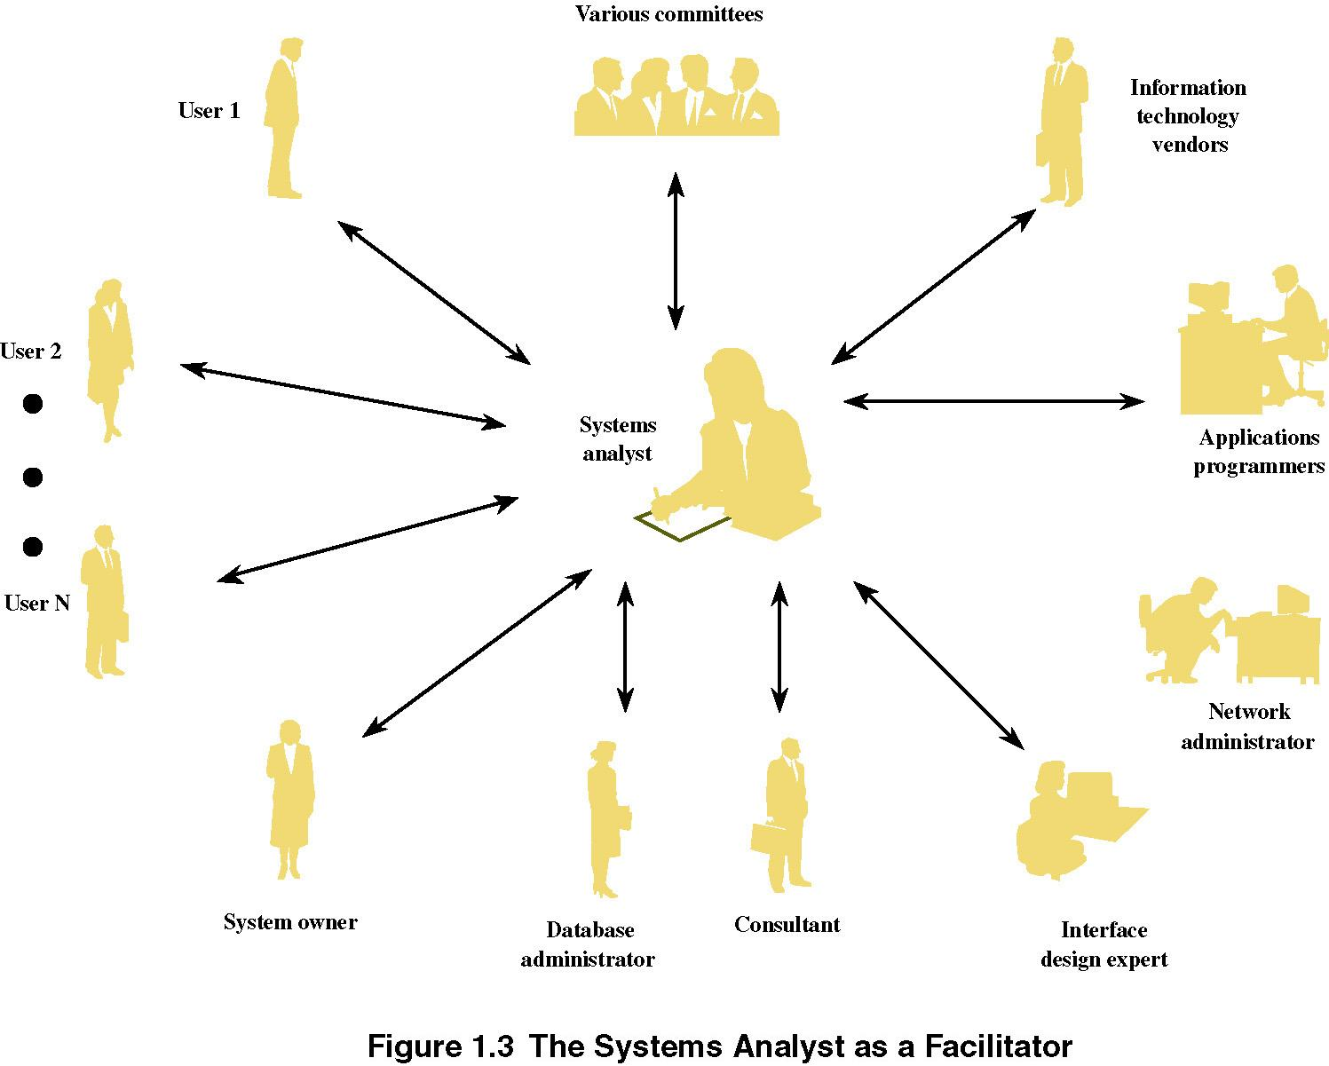
The Systems Analyst as a Facilitator
Notes:
No additional notes

Slide 25
A Simple System Development Process (pg 30)
System development process – a set of activities, methods, best practices, deliverables, and automated tools that stakeholders use to develop and maintain information systems and software.
A generic problem-solving approach
Identify the problem.
Analyze and understand the problem.
Identify solution requirements or expectations.
Identify alternative solutions and choose the “best” course of action.
Design the chosen solution.
Implement the chosen solution.
Evaluate the results. If the problem is not solved, return to step 1 or 2 as appropriate.
Notes:
Teaching Notes
This is not an actual system development life cycle or methodology but simply general problem-solving steps.

Slide 26
System Development Process Overview (pg 32 – 34)
System initiation – the initial planning for a project to define initial business scope, goals, schedule, and budget.
System analysis – the study of a business problem domain to recommend improvements and specify the business requirements and priorities for the solution.
System design – the specification or construction of a technical, computer-based solution for the business requirements identified in a system analysis.
System implementation – the construction, installation, testing, and delivery of a system into production.
Notes:
Teaching Notes
This is essentially the traditional System Development Life Cycle (SDLC) without the system support phase. We elected not to use that term because it invokes negative connotation for many instructors. Some associate it with a pure waterfall development approach (which we consider unfair). We differentiate between development and operation (sometimes called production).
System support is presented in the 6th edition as a separate project – a maintenance or enhancement project that should follow the exact same problem-solving approach, though on a more limited scale.

Slide 27
Project and Process Management (pg 74)
Project management – the activity of defining, planning, directing, monitoring, and controlling a project to develop an acceptable system within the allotted time and budget.
Process management – the ongoing activity that defines, improves, and coordinates the use of an organization’s chosen methodology (the “process”) and standards for all system development projects.
Notes:
Conversion Notes
This slide is new to the 6th edition

Slide 28
An Example of a System

Slide 29
An Example of a System

Slide 30
An Example of a System

Slide 31
An Example of a System

Slide 32
An Example System

Slide 33
Systems Analysts (pg 11)
A systems analyst studies the problems and needs of an organization to determine how people, data, processes, communications, and information technology can best accomplish improvements for the business. When information technology is used, the analyst is responsible for:
The efficient capture of data from its business source,
The flow of that data to the computer,
The processing and storage of that data by the computer, and
The flow of useful and timely information back to the business and its people.
Notes:
Teaching Notes
Actually, we offered two definitions in the chapter. First, we characterized the systems analyst as a “facilitator” of the other stakeholders’ participation in systems development. Then we offered the more precise definition in this slide.

Slide 34
The Analyst’s Dilemma
A man is flying in a hot air balloon and realizes he is lost. He reduces height and spots a man down below. He lowers the balloon further and shouts: "Excuse me, can you tell me where I am?"
The man below says: "Yes, you're in a hot air balloon, hovering 30 feet above this field."
"You must work in Information Technology" says the balloonist. "I do" replies the man. "How did you know."

Slide 35
The Analyst’s Dilemma (cont.)
"Well" says the balloonist, "everything you have told me is technically correct, but it's no use to anyone."
The man below says "you must work in business." "I do" replies the balloonist, "but how did you know?"
"Well", says the man, "you don't know where you are, or where you're going, but you expect me to be able to help. You're in the same position you were before we met, but now it's my fault."

Slide 36
Systems Analyst as Problem Solver
Problem solving is the act of studying a problem
environment in order to implement corrective solutions
Problems versus opportunities
A business problem solver
Analysts need to ‘sell’ change
The very best actually change their organizations
Systems analysts must keep up with rapidly changing technologies, but today’s priorities are rapidly shifting from technology-driven solutions to business-driven solutions.
Notes:
Problem Solving
Lorry stuck under the bridge, little boy who suggests let the air out of the tyres
Best Change their organisations
CIO who gets promoted to the role of CEO

Slide 37
General Problem-Solving Approach
1. Identify the problem.
2. Analyze and understand the problem.
3. Identify solution requirements or expectations.
4. Identify alternative solutions and decide a course of action.
5. Design and implement the “best” solution.
6. Evaluate the results. If the problem is not solved, return to step 1 or 2 as appropriate.
Notes:
Conversion Notes
We replaced the phase-like naming of the problem-solving steps introduced in Chapter 1 of the 4th edition (p. 9). This should prevent some students and instructors from confusing these problem-solving steps with an actual system development life cycle or methodology (introduced in Chapter 3).

Slide 38
Traits of a Good Systems Analyst
A good systems analysts can:
communicate with management and users
document their experience
understand problems before proposing solutions
think before they speak
facilitate systems development not originate it
are supportive of the organization in question and understand its goals and objectives
use good tools and approaches to help solve systems problems
enjoy working with people

Slide 39
Skills Required by Systems Analysts (pg 14)
Working knowledge of information technology
Computer programming experience and expertise
General business knowledge
Problem-solving skills
Interpersonal communication skills
Interpersonal relations skills
Flexibility and adaptability
Character and ethics
Systems analysis and design skills
Notes:
No additional notes

Slide 40
The Primary Focus
The primary focus on anything you in this course, and in industry
must be
KWUALITEE

Slide 41
The Primary Focus
The primary focus on anything you in this course, and in industry
must be
QUALITY

Slide 42
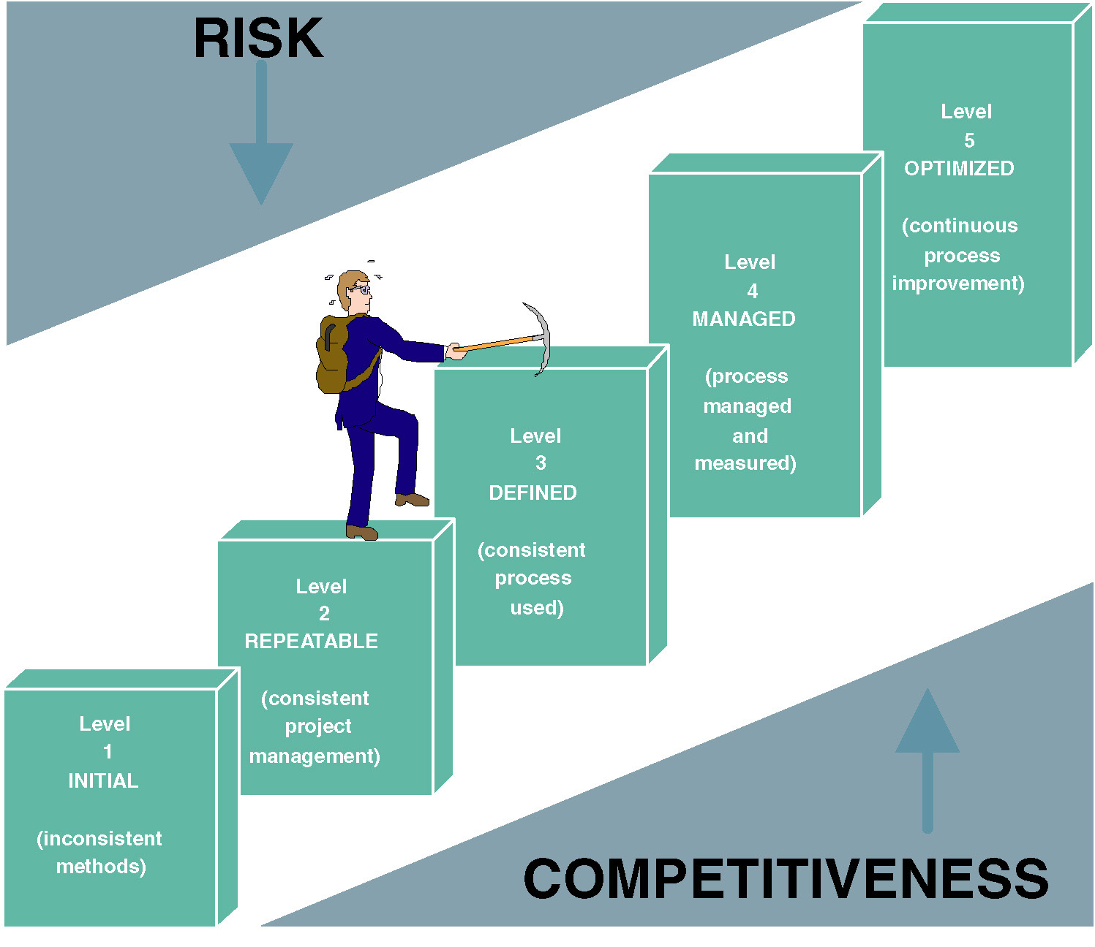
Capability Maturity Model (CMM: pg 69)
Notes:
No additional notes

Slide 43
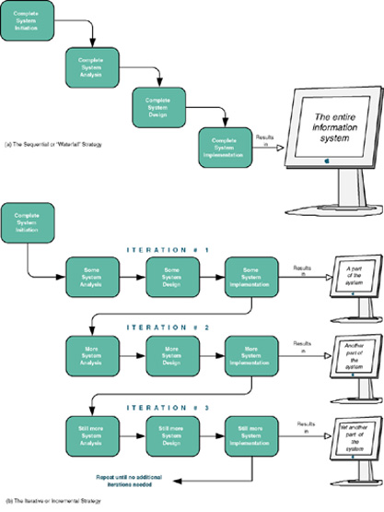
Sequential versus Iterative Development (pg 91)
Waterfall development approach an approach to systems analysis and design that completes each phase one after another and only once .
Iterative development approach an approach to systems analysis and design that completes the entire information system in successive iterations. Each iterations does some analysis, some design, and some construction. Synonyms include incremental and spiral.
Notes:
Conversion Notes
This slide and figure is new to the 6th edition
Teaching Notes
Sequential processes are one alternative. This is often called a “waterfall development” process.
An iterative or incremental development process develops and placed into operation a portion of the new system as quickly as possible and then moves on to other parts of the system.
Consider asking students to come up with pros and cons of each approach. For instance, the iterative approach gives the users some of what they want much sooner than the sequential approach. But the sequential approach is less likely to require fixes and redesigns to what has previously been implemented.

